Slide 1
ADDER
BY
SHASHI KIRAN REDDY
SUJAY
SAMEER
SYED MUSADDIQ FARAZ
MENTOR
PROF. BHAVANI SHANKAR

Slide 2
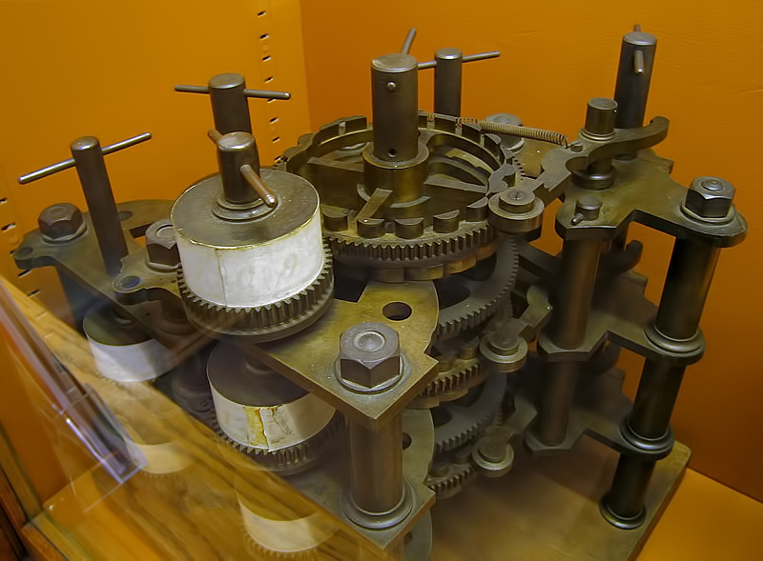
INTRODUCTION
Part of Charles Babbage's Difference Engine including the addition and carry mechanisms

Slide 3
Introduction
Adders are the fundamental part of an Arithmetic Logic Unit of a CPU.
Blaise Pascal along with Wilhelm Schickard was one of two inventors of the mechanical calculator in the early 17th Century.
The previously shown device (part of the device) was invented by Charles Babbage. It is called a Difference machine. Difference engines are strictly calculators.
There are many designs for binary adders. The basic adder design is a full adder, with 3 inputs and 2 outputs for single bit addition.
The adders are cascaded to make an adder that accepts larger input. Some of the adder designs are:
Ripple-carry adder
Carry-lookahead adders
Carry-Select Adder
Etc…

Slide 4
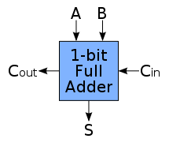
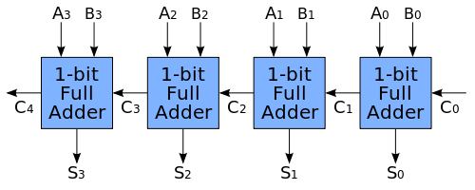
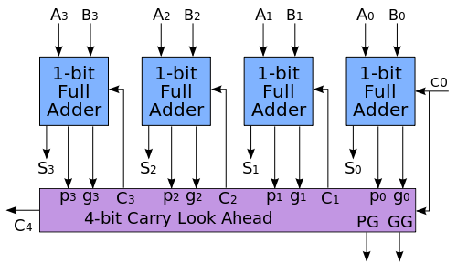
Introduction
Full Adder
4-bit Ripple Carry Adder
Carry Look Ahead Adder

Slide 5
PROBLEM STATEMENT
“Addition of two large numbers using circular ”- We know how to add two integers using a perfectly simple and useful algorithm learned from school or even earlier. This is perhaps one of the very first techniques we learn in mathematics.
What about big integers?
Since we know how to add “small” integers, its not so hard to apply the same algorithm on big integers. The only problem is that the addition will be slower and sometimes (done by humans) can be error prone.
So practically the algorithm is the same, but we can’t just put a 1 million integer into a standard computer type INT, right? That means, the question here is how we represent/store/execute such “big integers” in our application. A common solution is to store the “big integer” into an array, but in this problem we store the “big integer” in a “CIRCULAR LINKED LIST” which makes the traversing much more easier and helps us to implement the serial ripple carry adder.
Comparison of the working of the Ripple Carry and Carry Look Ahead Adder designs.

Slide 6
IMPLEMENTATION
The Programming language used is C for main calculations and Python (with GTK+ module) for GUI.
Using the above stated designs The Ripple Carry Adder and Carry Look Ahead Adder logic we tried to approach the solution to the problem.
The Ripple carry adder is implemented using the data structure Circular Linked List. An extra variable CARRY is maintained to ripple the value of currently generated carry to the next Full Adder.
The Carry Look Ahead Adder is implemented using 5 single dimensional arrays.
( Num1/Sum,Num2,Carry,Generator,Propagator )

Slide 7
ALGORITHM
Algorithm serialAdder(a[1,2,..,n], b[1,2,...m])
//Algorithm to compute the sum of two large positive numbers
//INPUT: two large positive numbers of size n and m, stored in the form of a linked list.
//OUTPUT: sum of numbers stored in the linked list.
carry = 0
for i = 1 to min(n , m) do //till we reach end of a number
s[i] = (a[i]+b[i]+carry) % 10
carry = (a[i]+b[i]+carry) /10
if(n<m) then // a has lesser number of digits
for i = n to m do
s[i] = (b[i]+carry) % 10
carry = (b[i]+carry) / 10
otherwise //b has lesser number of digits
for i = m to n do
s[i] = (a[i]+carry) % 10
carry = (a[i]+carry) / 10
Here a[i], b[i], s[i] are the ith elements of the linked list.

Slide 8
ALGORITHM
Algorithm clal ( i,G,P)
//Algorithm computes the carry produced for ith place
if(i==0)
return 0;
if(G[i-1] == 1)
return 1;
else if(P[i-1]==9)
return clal(i-1,g,p);
else
return 0;
G[i] = (X[i] + Y[i]) / 10
P[i] = (X[i] + Y[i]) % 10
C[i] = G[i] | ((P[i]==9) ? C[i-1] : 0)
// Achevied by calling C[i] = clal(i,G,P)
S[i] = (P[i] + c[i]) % 10
Eg: 9 + 8 = 17
G = 1 ( carry ) P = 7

Slide 9
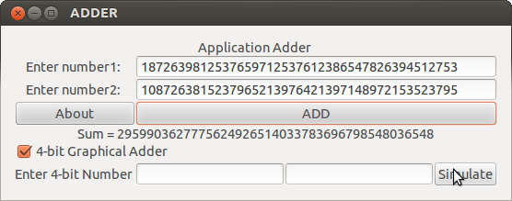
Result
On executing the python script we get the above GUI. The sample output of the program is being displayed. It can add any large number really fast.
There is also an option given to simulate the working of the serial adder. A graphics program using python has been written to get the desired result.
Both the programs generate the desired output but the serial adder being faster in generating the required result.(exactly opposite of the prediction, due to overhead of creating and synchronizing the threads)

Slide 10
Analysis
The theoretical and practical values of the time complexity of the serial adder is O(n) where n being the number of digits in the numbers.
The theoretical value of the time complexity of Carry Look Ahead Adder is O(log(n)), but there is a lot of variation in the practical value.. We don’t exactly get O(log(n)) since the 100% parallelism can’t be achieved. We can generate a maximum of 4 parallel threads. ( target machine processor – INTEL core i5) There is a lot of overhead in creating and synchronising the generated threads.

Slide 11
Conclusion
The Project successfully generates the desired output and iis efficient in its addition. The serial adder has a time complexity of O(n).
The project also successfully compares the working of a serial carry ripple adder and the carry look ahead adder.
The above method can be used to handle very large numbers with a little space tradeoff. The program can be made even more efficient by utilising the maximum int capacity in a single node.

Slide 12
Something Learned
While testing for the time complexity of our program we had produced a new run time error.
Error stated
**** stack smashing detected ***: ./a.out terminated*
We found that the above error is due to one of the methods of Buffer overflow protection.
The compiler we used for compiling our C programs is GCC. GCC comes with many security measures (CANARIES) and SSP(stack smashing protection) being one of it.
When we compared the time complexity with various set of values for n(number of digits) for the serial and fast adder, we found that the serial adder was way faster ( in the order of 50). We were confused initially but made the following conclusion after analising the working of parallel programming:
The amount of time taken to create and synchronize the thread had a lot of effect on the time complexity.
The actual number of threads that works simultaneously depends on the system architecture, (in our case no of threads = 4, quad core processor). Even though we are able to calculate all the carries in parallel the hardware limits the number of parallel computations.
Since the data is shared between the threads, shared memory model is used, which is again an overhead for the computation.

